Slide 1
Influential Nursing Leadership
Case Study Presentation
Lori Aberle, Mary Al-Khazraji, Tricia Brown

Slide 2
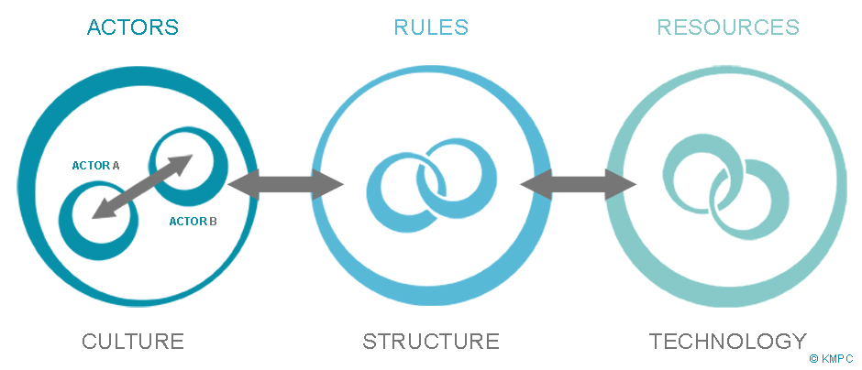
Inspiring Greatness
Lynn, the dean of the College of Nursing, has a vision for change. She sees the need for interdisciplinary collaboration to ensure optimal patient outcomes, professional role satisfaction, and healthcare excellence. She proposes to develop an interprofessional curriculum for the colleges of nursing, medicine, pharmacy, and social services. She develops a proposal of the intercollege planning committee and the provost that outlines a number of courses that could be taught with an integrated curriculum to students from each of the colleges. She is met with barriers that come along with change in a complex adaptive system. Lynn uses her experience, optimism, and understanding to lead the change. Within the year, the committee accepts the proposal for an interprofessional curriculum to begin the next year.

Slide 3
Problem
Conflict and Resistance
How to manage those who do not embrace her vision
Resistance from naysayers, “It can’t be done”, “We’ve never done it before”, “We are successful with the current curriculum structure”.
Intense, chaotic meetings filled with motion and discouragement

Slide 4
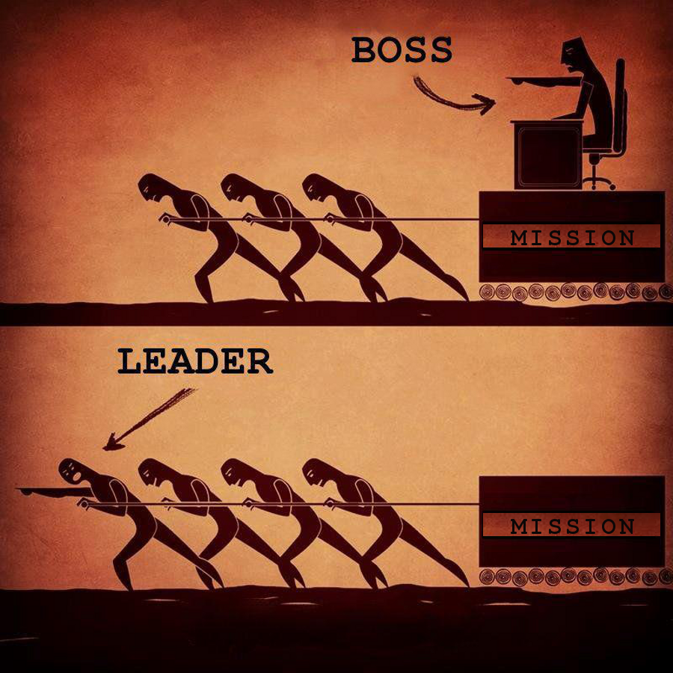
Relevance to Nurse Leaders
Lynn models several key elements of leadership:
Fluidity
Facilitate necessary change
Concern with adapting to change
Discern predominant operating variables
Ability to thrive in the potential of life and experience
(Porter-O’Grady, Malloch, 2018)
Notes:
Identify the elements of complexity in this case study.
Elements of complexity in Lynn’s leadership:
-Fluidity has become a characteristic of doing business and managing life in every human arena, it is necessary to be able to adjust course (Porter-O’Grady, Malloch, 2018).
-Lynn is working to facilitate change by through her limitless and boundless vision to establish interprofessional curricula
-She seeks to listen carefully to the naysayers and understand their perspective on the matter and their concerns and fears
-Anticipates there will be resistance, recognizes that the discord is an important part of the process, realizes the value of the change process
-Lynn recognizes the need to be patient, keeps focused with positive energy and strong belief, seeks to find a way to focus attention on what is shared in common in the vision and highlights areas where they are interdependent on one another to achieve their vision

Slide 5
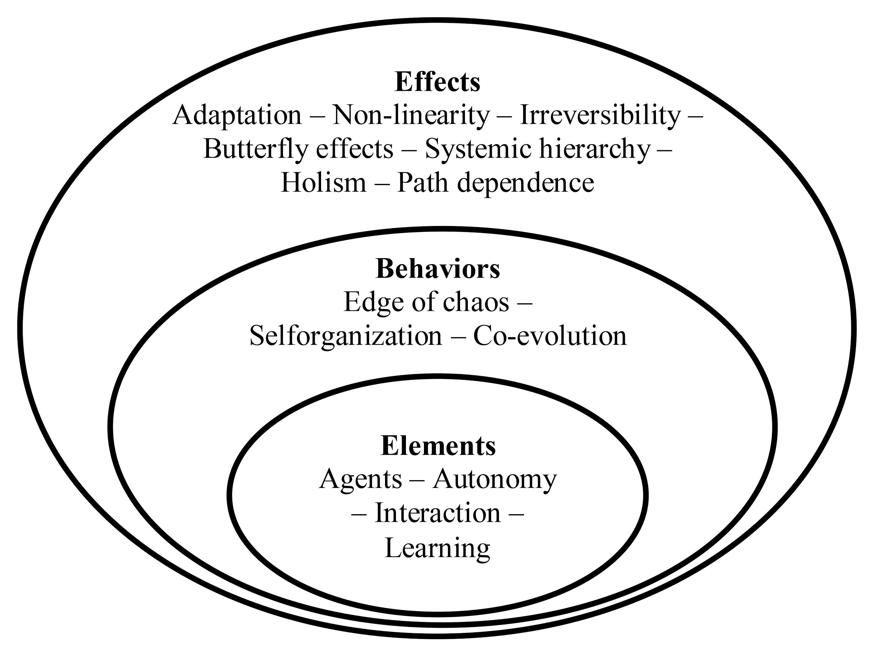
Potential Causes to Problem
Many independent entities
Multiple barriers
Naysayers
Resistance to change
Intense, chaotic, meetings
Constant in motion
Opposing Visions
(Porter-O’Grady, Malloch, 2018)
Notes:
Element of the systems complexity
According to McKimm & Till (2015)
There are four Key Underlying ideas:
1. The mechanisms of collective behaviour (patterns)
2. A multi-scale perspective (the way different observers or stakeholders describe a system)
3. The evolutionary process that describes complex systems
4. The nature of purposive or goal-directed behaviour (

Slide 6
OPTIONS FOR RESOLUTION
A good leader can read the signposts suggesting that change is imminent, discern the direction of the changes, and determine adjustments to stay viable (Porter & Malloch, 2018).
Accountability to profession
Maintain expertise in clinical area
Involvement in Professional Organizations
Adaptability to most current information allows for changes and innovation
Anticipating need for change helps form vision

Slide 7
The Vision
“The most important task of healthcare leaders is to communicate their vision, not so much by their words but by their behavior. If the leaders cannot respond appropriately to the demand for change, others will not be able to either.”
Porter-O’Grady-Malloch (2018)

Slide 8
Managing Vision
Provide information about the vision and build your team
Leaders who do not spend sufficient time constructing effective teams pay a price (Porter-O’Grady & Malloch, 2018)
Use emotional intelligence (Stichler, 2006)
Remember that conflict is normal
Consider transtheoretical model of change applied to the institution. (Clark, 2013).
Anticipate resistance
Include naysayers in discussion to find common ground
Focus on the issues and goal
Stay positive

Slide 9
Keeping the Process Moving
Kotter’s eight accelerators can be applied to any change situation, using accelerators in an iterative way rather than a checklist for momentum. (McKimm & Till, 2015)
Use of constructive conflict has a potential as a vehicle for challenging people’s underlying assumptions and mental models and enhancing their ability to think in more interprofessional terms. (Ginsburg & Tregunno, 2005)

Slide 10
Play the Role of the Quantum Leader
Guide
Empower
Notes:
A quantum leader must be able to guide their staff, providing information and choices. They must read and interpret the signposts along the way. Ultimately they are to empower their employees to take their guidance and develop their own practice and decision making- just as the case study shows Lynn led them to a place where they had agency in making the decision

Slide 11
Conclusion: Lead the change
Proposed topics that are quantum in nature
Include members of groups from the whole organization
Accept the chaos of the situation and uses it as an advantage
Adapts by bringing in more information
Notes:
In the case study, Lynn did not employ a hierarchical or Newtonian “top down” style of leadership- it was clearly quantum leadership. By proposing interprofessional education she recognizes the quantum nature of differing parts of the system working together. She prepares herself for the chaos and doubt brought on by naysayers with thier “we’ve never done this before”. She adapts by bringing in journals and speaking engagements in order to provide more information to the staff.

Slide 12
Questions
Does anyone have experience with conflict?
What has been the most difficult part of leading change?
What are some ways we as leaders can listen for change?
Going to school while working full time is not easy, are there aspects of conflict resolution that can be applied to this situation?

Slide 13
References
Clark, P.G. (2013). Toward a transtheoretical model of interprofessional education:
stages, processes and forces supporting institutional change. Journal of
Interprofessional Care, 27, 43-49.
Ginsburg, L. & Tregunno, D. (2005). New approaches to interprofessional education
and collaborative practice: lesions from the organizational change literature.
Journal of Interprofessional Care, (1) (Suppl.), 177-187.

Slide 14
References
McKimm, J. & Till, A. (2015). Leadership in Practice. British Journal of Hospital
Medicine, 76(4), 239-243.
Porter-O’Grady, T. & Malloch, K. (2018). Quantum leadership: Creating sustainable
value in health care (5th ed.). Burlington, MA: Jones & Bartlett Learning.
Stichler, J. F. (2006), Emotional Intelligence. AWHONN Lifelines, 10(5), 422–425.
doi:10.1111/j.1552-6356.2006.00083.x

